Slide 1
Synthetic polymers for Tissue Engineering

Slide 2
Synthetic Polymers
WHY?
Advantages over natural polymer
Specific functions (surface modification)
Controllable properties (shape and structure)
They are polyesters
Polyanhydrites, Polycarbonates and polyphosphazanes.
They degrade hydrolytically, their degradation could be controlled to match the host.
Disadvantage (Result in acid products afer degradation)

Slide 3
Few examples
Poly(glycolic acid)
Poly(L-lactic acid)
Poly(D,L-lactic acid-co-glycolic acid)
Poly(caprolactone)
Poly(propylene fumarate)

Slide 4
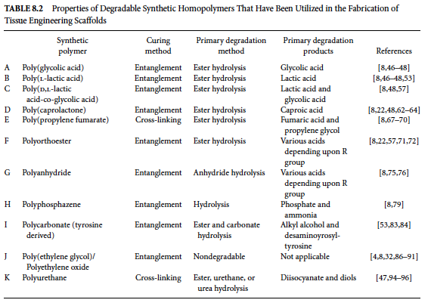

Slide 5
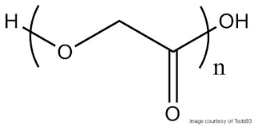
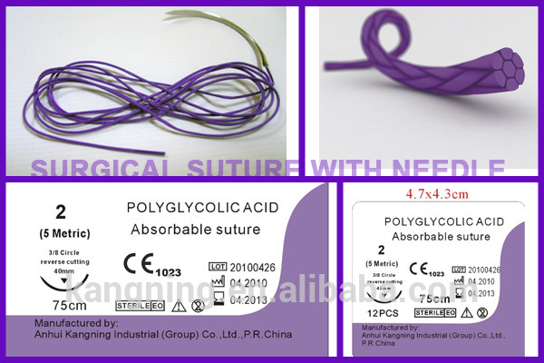
Poly(glycolic) Acid
Tissue engineering scaffolds made with polyglycolide have been produced following different approaches, but generally most of these are obtained through textile technologies in the form of non-woven meshes.
High molecular weight polyglycolide is been used for food packaging applications under the tradename of Kuredux.

Slide 6
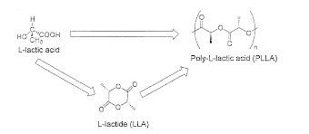
Poly (L-lactic) Acid
successful in the delivery of amoxicillin for the treatment listeriosis (treatment of Listeria monocytogenes infection).
a commercially available drug delivery device using PLGA is Lupron Depot for the treatment of advanced prostate cancer.
prophylactic delivery of the antibiotic vancomycin into the central nervous system when applied to the surface of the brain after brain surgery

Slide 7
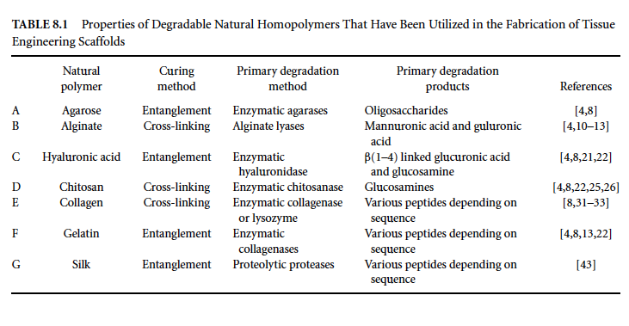

Slide 8
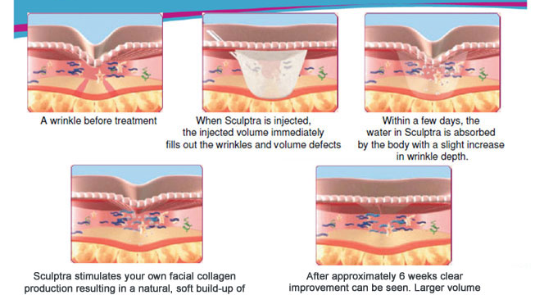
Sculptra is a proprietary formulation of poly-l-lactic acid that is an FDA-approved dermal filler manufactured by Dermik Laboratories.

Slide 9

Poly(D,L-lactic acid-co-glycolic acid)

